Slide 1
Probabilistic Programming
Marius Popescu
popescunmarius@gmail.com
2018 - 2019

Slide 2

TensorFlow Probability / Edward2

Slide 3
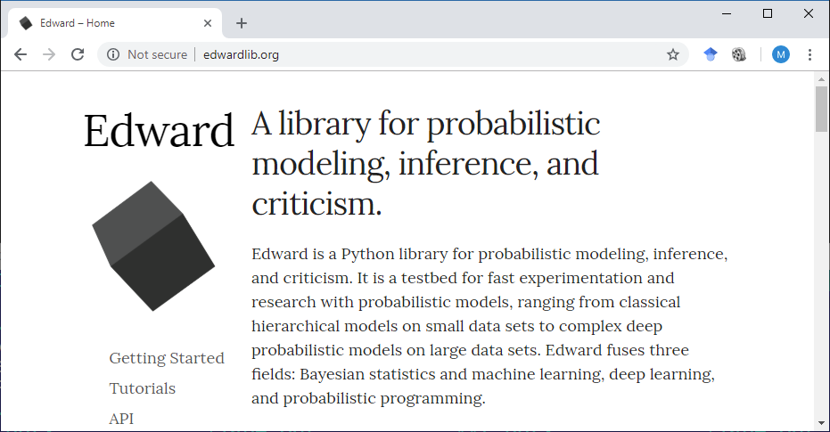
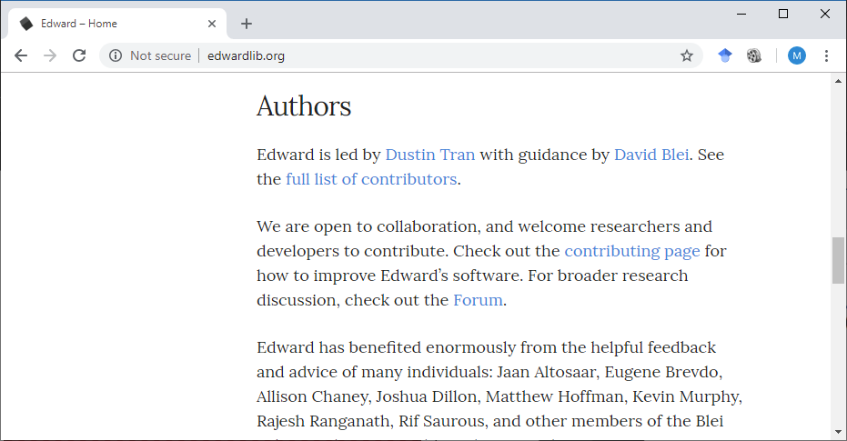


Some History

Slide 4
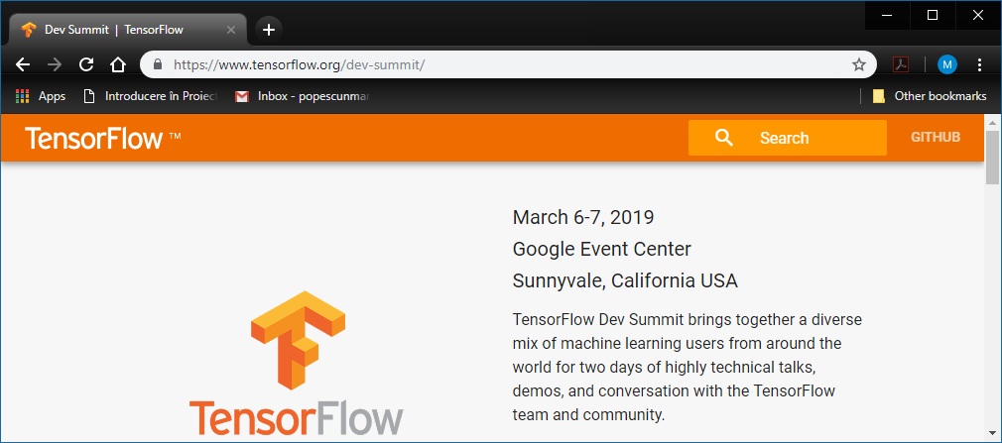

Some History

Slide 5
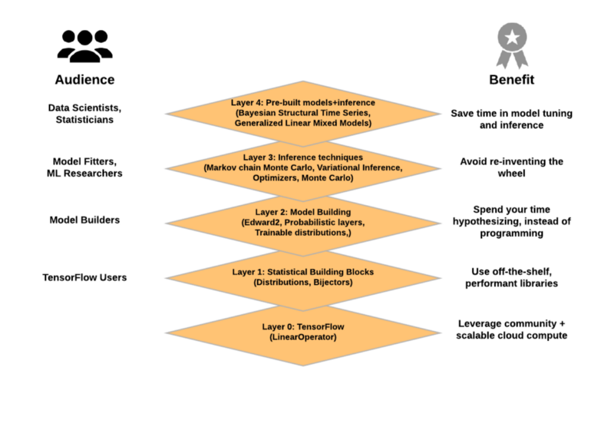
TFP
TensorFlow Probability (TFP) is a Python library built on TensorFlow that makes it easy to combine probabilistic models and deep learning on modern hardware (TPU, GPU).
It is a probabilistic programming toolbox for machine learning researchers and practitioners provides modular abstractions for probabilistic reasoning and statistical analysis in the TensorFlow ecosystem.

Slide 6
TFP Layer 1: Statistical Building Blocks
Distributions (tf.contrib.distributions, tf.distributions): A large collection of probability distributions and related statistics with batch and broadcasting semantics.
Bijectors (tf.contrib.distributions.bijectors): Reversible and composable transformations of random variables. Bijectors provide a rich class of transformed distributions, from classical examples like the log-normal distribution to sophisticated deep learning models such as masked autoregressive flows.

Slide 7
TFP Layer 2: Model Building
Edward2 (tfp.edward2): A probabilistic programming language for specifying flexible probabilistic models as programs.
Probabilistic Layers (tfp.layers): Neural network layers with uncertainty over the functions they represent, extending TensorFlow Layers.
Trainable Distributions (tfp.trainable_distributions): Probability distributions parameterized by a single Tensor, making it easy to build neural nets that output probability distributions.

Slide 8
TFP Layer 3: Probabilistic Inference
Markov chain Monte Carlo (tfp.mcmc): Algorithms for approximating integrals via sampling. Includes Hamiltonian Monte Carlo, random-walk Metropolis-Hastings, and the ability to build custom transition kernels.
Variational Inference (tfp.vi): Algorithms for approximating integrals via optimization.
Optimizers (tfp.optimizer): Stochastic optimization methods, extending TensorFlow Optimizers. Includes Stochastic Gradient Langevin Dynamics.
Monte Carlo (tfp.monte_carlo): Tools for computing Monte Carlo expectations.

Slide 9
TFP Layer 4: Pre-made Models and Inference
Bayesian structural time series: High-level interface for fitting time-series models (i.e., similar to R’s BSTS package).
Generalized Linear Mixed Models: High-level interface for fitting mixed-effects regression models (i.e., similar to R’s lme4 package).

Slide 10
TensorFlow Basics

Slide 11

import tensorflow as tf

Slide 12
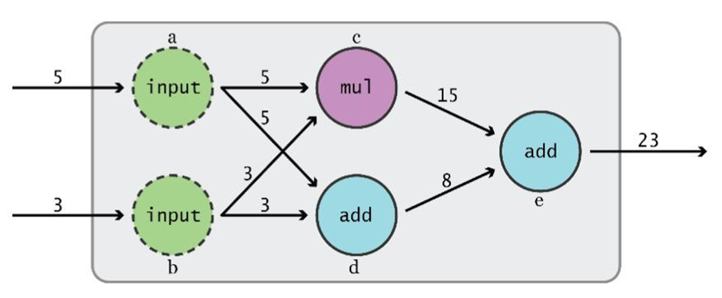
Data Flow Graphs
TensorFlow separates definition of computations from their execution
Phase 1: assemble a graph
Phase 2: use a session to execute operations in the graph.
This might change in the future; in TensorFlow 2.0 the Eager execution will be the standard execution mode.

Slide 13
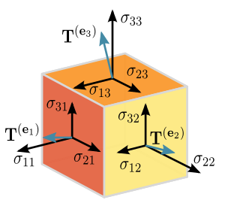

What’s a tensor?
In Mathematics
In TensorFlow
A tensor is an arbitrarily complex geometric object that maps in a (multi-)linear manner geometric vectors, scalars, and other tensors to a resulting tensor. Thereby, vectors and scalars themselves are considered as the simplest tensors.
An n-dimensional array{
0-d / rank 0 tensor: scalar (number)
1-d / rank 1 tensor: vector
2-d / rank 2 tensor: matrix
...

Slide 14
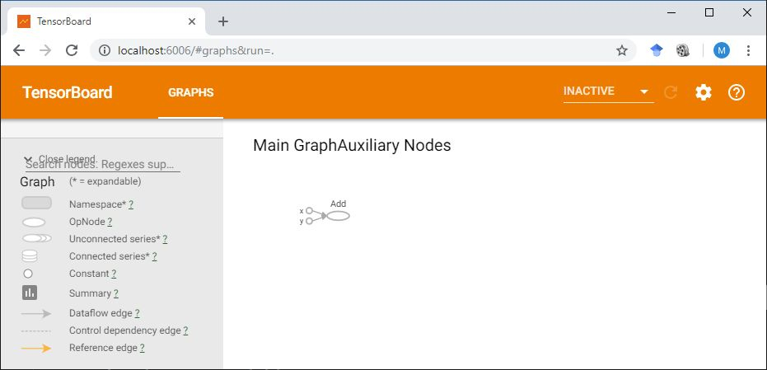
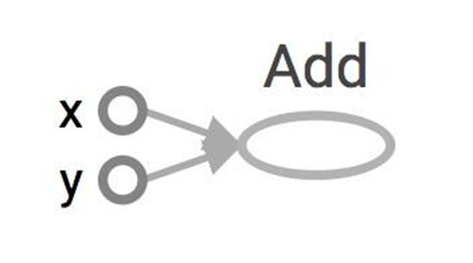
Data Flow Graphs
>>>import tensorflow as tf >>>a = tf.add(3, 5)
Why x, y?
TF automatically names the nodes when you don’t explicitly name them.
x = 3
y = 5

Slide 15
Data Flow Graphs
>>>import tensorflow as tf >>>a = tf.add(3, 5)
Nodes: operators, variables, and constants
Edges: tensors
Tensors are data.
TensorFlow = tensor + flow = data + flow
Interpretation?

Slide 16
Data Flow Graphs
>>>import tensorflow as tf >>>a = tf.add(3, 5)
>>>print(a)
Tensor("Add:0", shape=(), dtype=int32)
Not 8

Slide 17
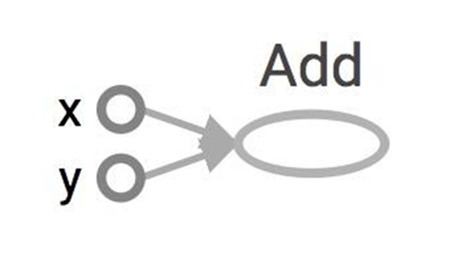
How to get the value of a?
Create a session, assign it to variable sess so we can call it later
Within the session, evaluate the graph to fetch the value of a
import tensorflow as tf a = tf.add(3, 5) sess = tf.Session() print(sess.run(a)) sess.close()

Slide 18
How to get the value of a?
Create a session, assign it to variable sess so we can call it later
Within the session, evaluate the graph to fetch the value of a
import tensorflow as tf a = tf.add(3, 5) sess = tf.Session() with tf.Session() as sess: print(sess.run(a)) sess.close()

Slide 19
tf.Session()
A Session object encapsulates the environment in which Operation objects are executed, and Tensor objects are evaluated.
A TensorFlow session is used to run parts of the graph to get the variables we want.

Slide 20
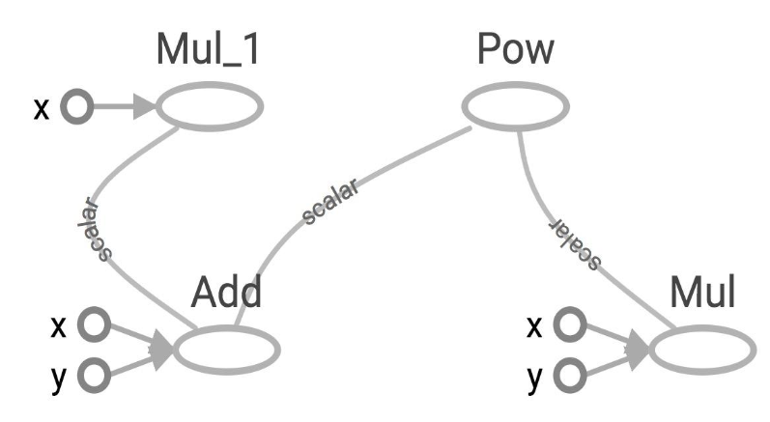
Subgraphs
x = 2 y = 3 add_op = tf.add(x, y) mul_op = tf.multiply(x, y) useless = tf.multiply(x, add_op) pow_op = tf.pow(add_op, mul_op) with tf.Session() as sess: z = sess.run(pow_op)
Because we only want the value of pow_op and pow_op doesn’t depend on useless, session won’t compute value of useless

Slide 21
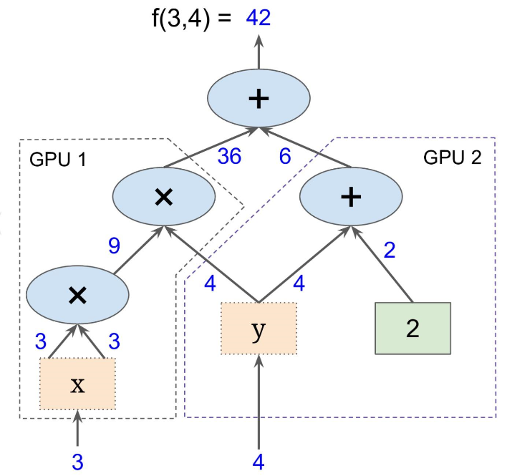
Subgraphs
Possible to break graphs into several chunks and run them parallelly across multiple CPUs, GPUs, TPUs, or other devices

Slide 22
Visualization with TensorBoard
import tensorflow as tf
a = tf.constant(2, name = 'a')
b = tf.constant(3, name = 'b')
x = tf.add(a, b, name = 'x')
writer = tf.summary.FileWriter('./graphs', tf.get_default_graph())
with tf.Session() as sess:
# writer = tf.summary.FileWriter('./graphs', sess.graph)
print(sess.run(x))
writer.close()

Slide 23
Visualization with TensorBoard
Run:
python yourprogram.py tensorboard --logdir="./graphs" --port 6006
Then open your browser and go to:
http://localhost:6006/

Slide 24
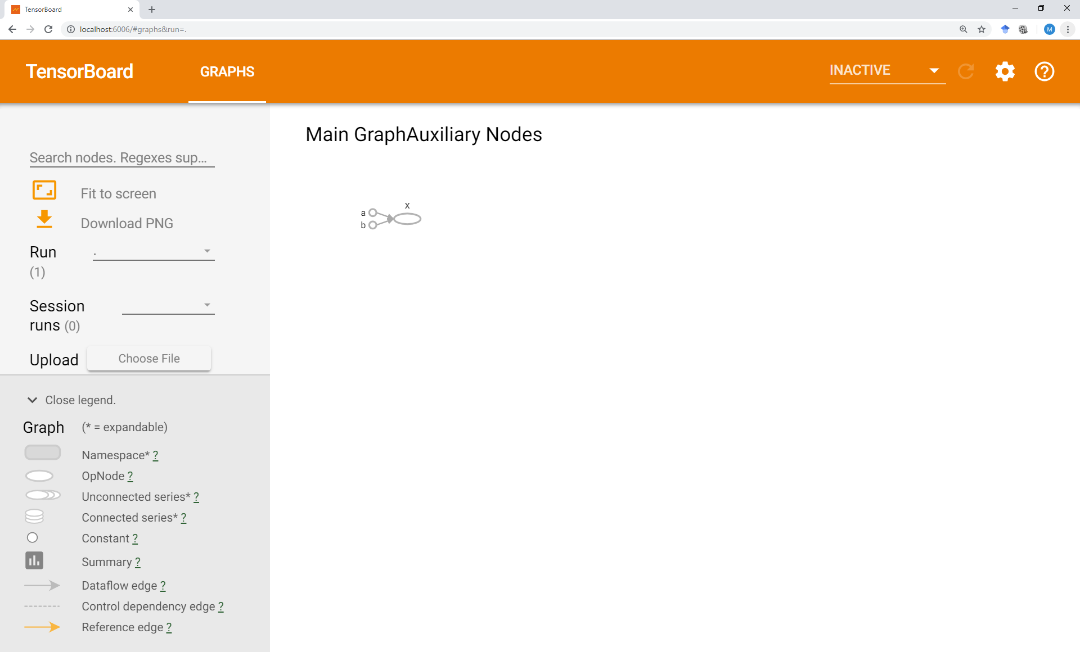
Visualization with TensorBoard

Slide 25
Tensors

Slide 26
tf.Tensor
Internally, TensorFlow represents tensors as n-dimensional arrays of base datatypes.
A tf.Tensor has the following properties:
a data type (float32, int32, or string, for example)
a shape

Slide 27
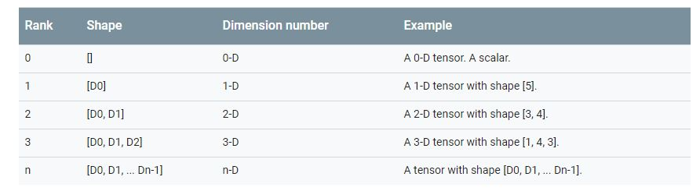
Shape
The TensorFlow documentation uses three notational conventions to describe tensor dimensionality: rank, shape, and dimension number.
Shapes can be represented via Python lists / tuples of ints, or with the tf.TensorShape.

Slide 28
Shape
Getting a tf.Tensor object's shape:
zeros = tf.zeros(my_matrix.shape[1]) # makes a vector of zeros with the same size
# as the number of columns in a given matrix
Changing the shape of a tf.Tensor:
rank_three_tensor = tf.ones([3, 4, 5])
matrix = tf.reshape(rank_three_tensor, [6, 10]) # Reshape existing content into
# a 6x10 matrix

Slide 29
Data Type
To inspect a tf.Tensor's data type use the Tensor.dtype property.
It is possible to cast tf.Tensors from one datatype to another using tf.cast:
# Cast a constant integer tensor into floating point.
float_tensor = tf.cast(tf.constant([1, 2, 3]), dtype=tf.float32)

Slide 30
Creating Tensors: Constants

Slide 31
Constants
a = tf.constant(3, name=‘a’)
a = tf.constant([2, 2], name='a’) a = tf.constant([[0, 1], [2, 3]], name=‘a')

Slide 32
Tensors filled with a specific value
tf.zeros(shape, dtype=tf.float32, name=None)
Creates a tensor of shape and all elements will be zeros
tf.zeros([2, 3], tf.int32) ==> [[0, 0, 0], [0, 0, 0]]

Slide 33
Tensors filled with a specific value
tf.zeros_like(input_tensor, dtype=None, name=None, optimize=True)
Creates a tensor of shape and type (unless type is specified) as the input_tensor but all elements are zeros.
# input_tensor is [[0, 1], [2, 3], [4, 5]]
tf.zeros_like(input_tensor) ==> [[0, 0], [0, 0], [0, 0]]

Slide 34
Tensors filled with a specific value
tf.ones(shape, dtype=tf.float32, name=None)
tf.ones_like(input_tensor, dtype=None, name=None, optimize=True)

Slide 35
Tensors filled with a specific value
tf.fill(dims, value, name=None)
Creates a tensor filled with a scalar value.
tf.fill([2, 3], 8) ==> [[8, 8, 8], [8, 8, 8]]

Slide 36
Constants as Sequences
tf.lin_space(start, stop, num, name=None) tf.lin_space(10.0, 13.0, 4) ==> [10. 11. 12. 13.]
tf.range(start, limit=None, delta=1, dtype=None, name='range') tf.range(3, 18, 3) ==> [3 6 9 12 15] tf.range(5) ==> [0 1 2 3 4]

Slide 37
Randomly Generated Constants
tf.random_normal
tf.truncated_normal
tf.random_uniform
tf.random_shuffle
tf.random_crop
tf.multinomial
tf.random_gamma

Slide 38
Creating Tensors: Operations

Slide 39
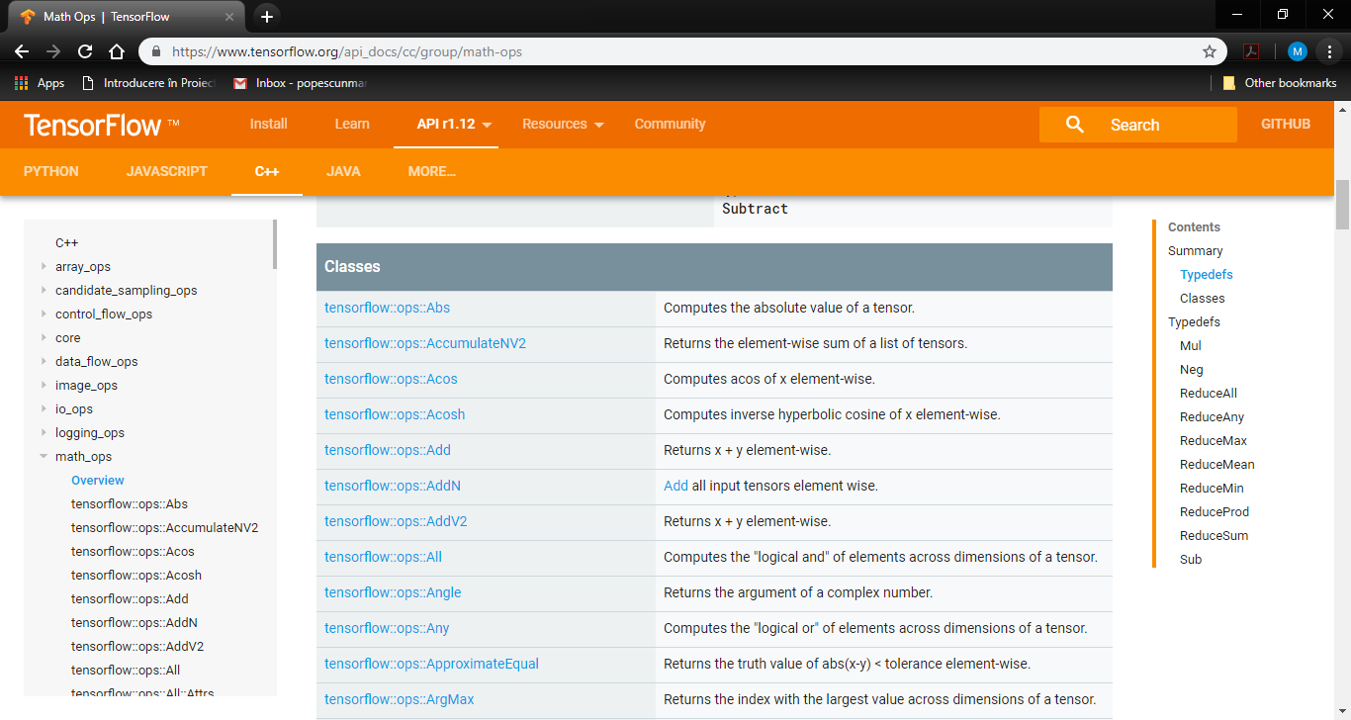

Slide 40
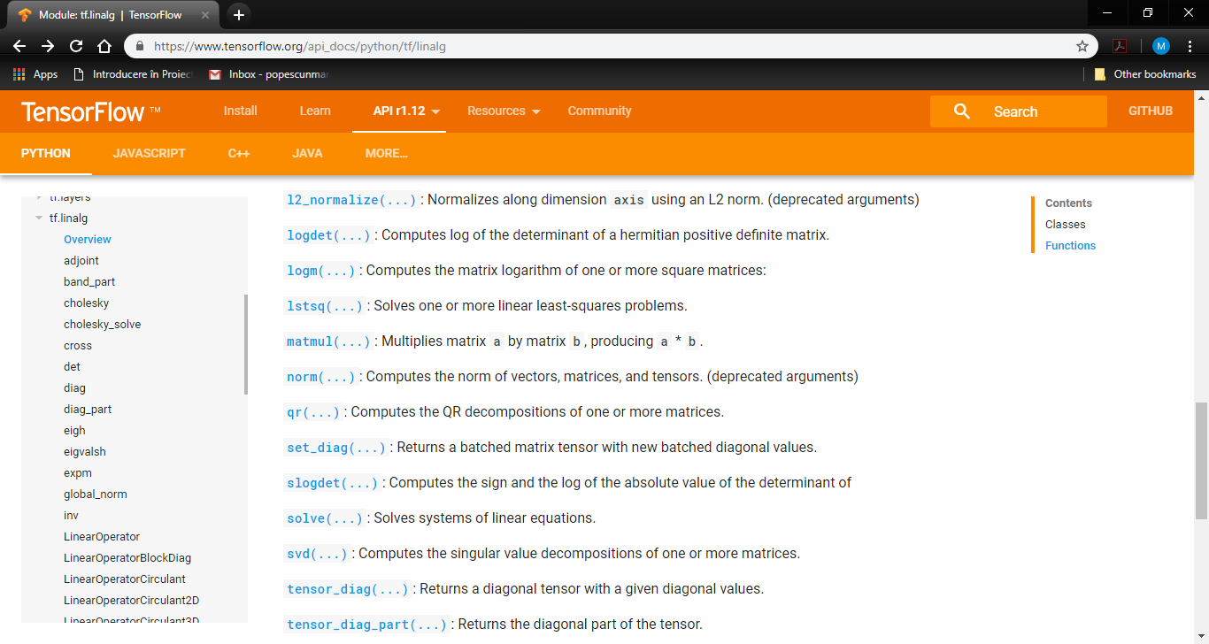

Slide 41
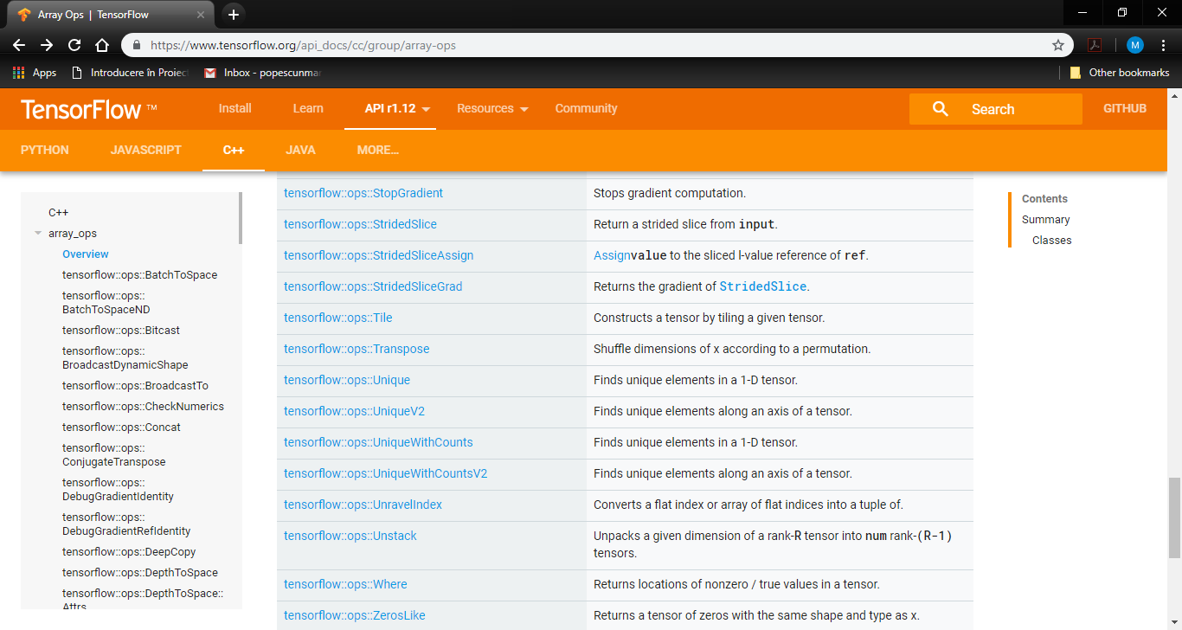

Slide 42
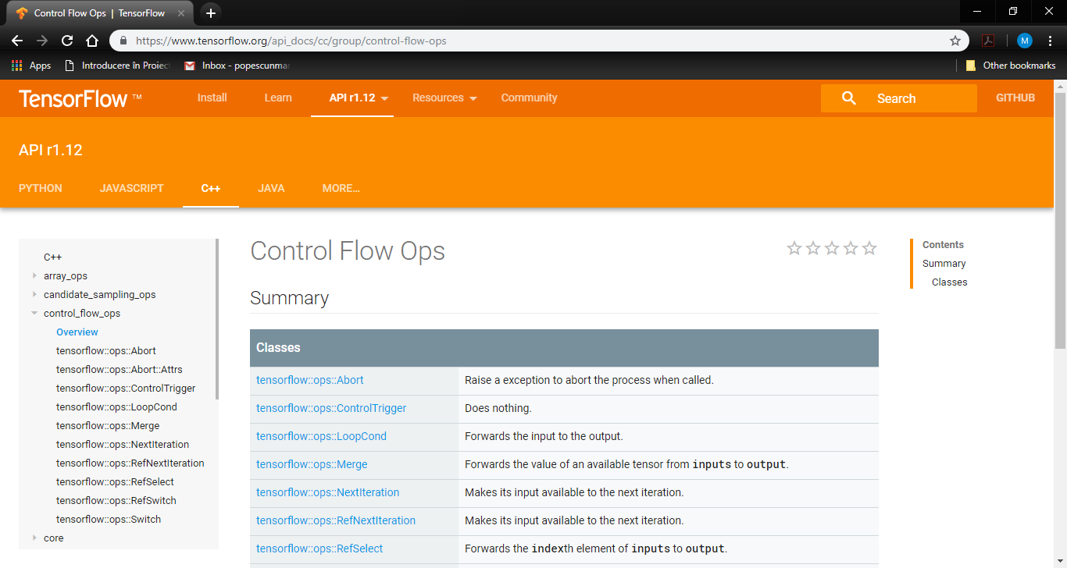

Slide 43
Variables

Slide 44
tf.Variable class
# create variables with tf.Variable
s = tf.Variable(2, name="scalar")
m = tf.Variable([[0, 1], [2, 3]], name="matrix")
W = tf.Variable(tf.zeros([784,10]))
# create variables with tf.get_variable
s = tf.get_variable("scalar", initializer=tf.constant(2))
m = tf.get_variable("matrix", initializer=tf.constant([[0, 1], [2, 3]]))
W = tf.get_variable("big_matrix", shape=(784, 10), initializer=tf.zeros_initializer())

Slide 45
tf.Variable holds several ops
x = tf.Variable(...)
x.initializer # init op
x.value() # read op
x.assign(...) # write op
x.assign_add(...) # and more

Slide 46
You have to initialize your variables
import tensorflow as tf
W = tf.get_variable("big_matrix", shape=(784, 10), initializer=tf.zeros_initializer())
with tf.Session() as sess: print(sess.run(W))
FailedPreconditionError: Attempting to use uninitialized value Variable
Initializer is an op. You need to execute it within the context of a session

Slide 47
You have to initialize your variables
# The easiest way is initializing all variables at once:
with tf.Session() as sess:
sess.run(tf.global_variables_initializer())
# Initialize only a subset of variables:
with tf.Session() as sess:
sess.run(tf.variables_initializer([a, b]))
# Initialize a single variable
W = tf.Variable(tf.zeros([784,10]))
with tf.Session() as sess:
sess.run(W.initializer)

Slide 48
Eval() a variable
# W is a random 700 x 10 variable object
W = tf.Variable(tf.truncated_normal([700, 10]))
with tf.Session() as sess:
sess.run(W.initializer)
print(W)
print(W.eval())
Tensor("Variable/read:0", shape=(700, 10), dtype=float32)
[[-0.76781619 -0.67020458 1.15333688 ..., -0.98434633 -1.25692499
-0.90904623]
[-0.36763489 -0.65037876 -1.52936983 ..., 0.19320194 -0.38379928
0.44387451]
[ 0.12510735 -0.82649058 0.4321366 ..., -0.3816964 0.70466036
1.33211911]
...,

Slide 49

tf.Variable.assign()
W = tf.Variable(10)
W.assign(100)
with tf.Session() as sess:
sess.run(W.initializer)
print(W.eval())
10
W = tf.Variable(10)
assign_op = W.assign(100)
with tf.Session() as sess:
sess.run(W.initializer)
sess.run(assign_op)
print(W.eval())
100
?
W.assign(100) creates an assign op. That op needs to be executed in a session to take effect.

Slide 50
tf.Variable.assign()
# create a variable whose original value is 2
my_var = tf.Variable(2, name="my_var")
# assign a * 2 to a and call that op a_times_two
my_var_times_two = my_var.assign(2 * my_var)
with tf.Session() as sess:
sess.run(my_var.initializer)
sess.run(my_var_times_two) # the value of my_var now is 4
sess.run(my_var_times_two) # the value of my_var now is 8
sess.run(my_var_times_two) # the value of my_var now is 16

Slide 51
“Hello World!”

Slide 52



Monty Hall Problem
Suppose you're on a game show, and you're given the choice of three doors: Behind one door is a car; behind the others, goats. You pick a door, say No. 1, and the host, who knows what's behind the doors, opens another door, say No. 3, which has a goat. He then says to you, "Do you want to pick door No. 2?" Is it to your advantage to switch your choice?

Slide 53
TFP Solution
import tensorflow as tf
from tensorflow_probability import edward2 as ed
N = 10000
car_door = ed.Categorical(probs=tf.constant([1. / 3., 1. / 3., 1. / 3.]), sample_shape = N, name = 'car_door')
picked_door = ed.Categorical(probs=tf.constant([1. / 3., 1. / 3., 1. / 3.]), sample_shape = N, name = 'picked_door')
preference = ed.Bernoulli(probs=tf.constant(0.5), sample_shape = N, name = 'preference’)
host_choice = tf.where(tf.not_equal(car_door, picked_door),
3 - car_door - picked_door,
tf.where(tf.equal(car_door, 2 * tf.ones(N, dtype=tf.int32)),
preference,
tf.where(tf.equal(car_door, tf.ones(N, dtype=tf.int32)),
2 * preference,
1 + preference)), name = 'host_choice’)
#changed_door = 3 - host_choice - picked_door
changed_door = tf.subtract(tf.subtract(3, host_choice), picked_door, name = 'changed_door')

Slide 54
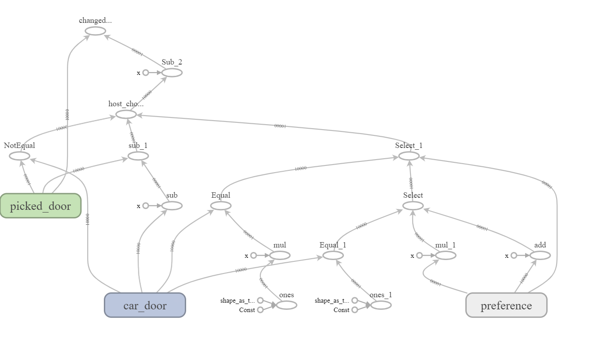
Data Flow Graphs (The Model)

Slide 55
Running
with tf.Session() as sess:
sess.run(tf.global_variables_initializer())
car_door_samples, picked_door_samples, changed_door_samples = sess.run([car_door, picked_door, changed_door])
print("probability to win of a player who stays with the initial choice:", (car_door_samples == picked_door_samples).mean())
print("probability to win of a player who switches:", (car_door_samples == changed_door_samples).mean())

Slide 56
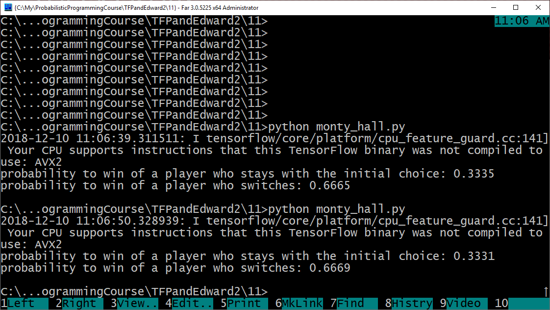
The Results

Slide 57
Project 1
Bayesian Neural Networks

Slide 58
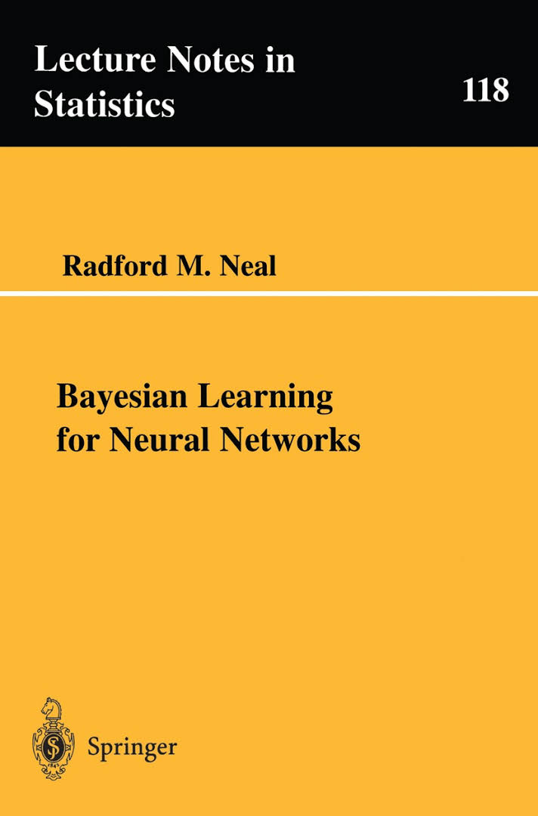
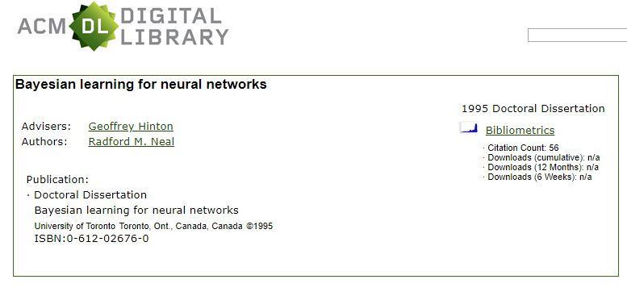
Bayesian Neural Networks
http://citeseerx.ist.psu.edu/viewdoc/download?doi=10.1.1.446.9306&rep=rep1&type=pdf

Slide 59
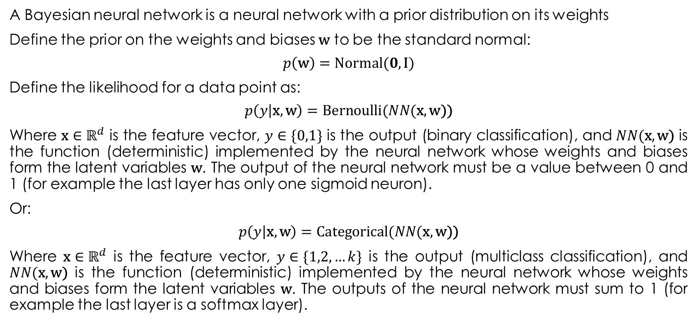
Bayesian Neural Networks
A Bayesian neural network is a neural network with a prior distribution on its weights
Define the prior on the weights and biases $\text{w}$ to be the standard normal:
$$p\left(\text{w}\right)=\text{Normal}(0, \text{I})$$
Define the likelihood for a data point as:
$$p\left(y | \text{x},\text{w}\right)=\text{Bernoulli}(NN(\text{x},\text{w}\text{))}$$
Where $\text{x}∈ℝ^{d}$ is the feature vector, $y∈\{0,1\}$ is the output (binary classification), and $NN(\text{x},\text{w}\text{)}$ is the function (deterministic) implemented by the neural network whose weights and biases form the latent variables $\text{w}$. The output of the neural network must be a value between 0 and 1 (for example the last layer has only one sigmoid neuron).
Or:
$$p\left(y | \text{x},\text{w}\right)=\text{Catego}\text{r}\text{ica}\text{l}(NN(\text{x},\text{w}\text{))}$$
Where $\text{x}∈ℝ^{d}$ is the feature vector, $y∈\{1,2,…k\}$ is the output (multiclass classification), and $NN(\text{x},\text{w}\text{)}$ is the function (deterministic) implemented by the neural network whose weights and biases form the latent variables $\text{w}$. The outputs of the neural network must sum to 1 (for example the last layer is a softmax layer).

Slide 60
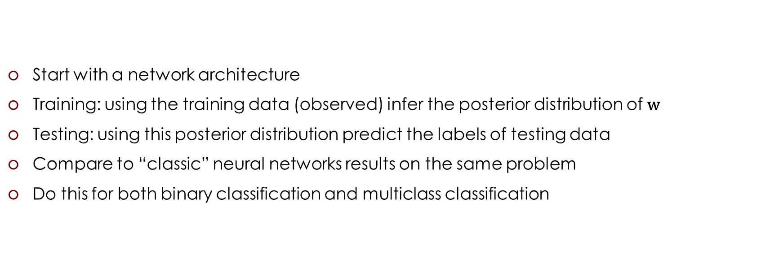
The Task
Start with a network architecture
Training: using the training data (observed) infer the posterior distribution of $\text{w}$
Testing: using this posterior distribution predict the labels of testing data
Compare to “classic” neural networks results on the same problem
Do this for both binary classification and multiclass classification

Slide 61
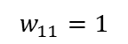
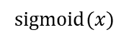
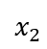
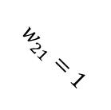
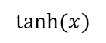
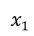
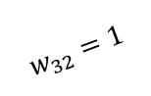
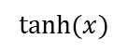
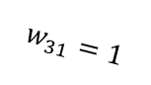
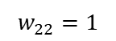
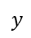
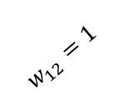
Sanity Check
Take a simple neural network with fixed weights
Generate labeled data (100 training, 100 testing) by feeding random input vectors into this network:
X = np.random.randn(100, 2)
Y = np.tanh(X[:, 0] + X[:, 1])
Y = 1. / (1. + np.exp(-(Y + Y)))
Y = Y > 0.5
$$w_{11}=1$$
$$tanh⁡(x)$$
$$x_{1}$$
$$w_{31}=1$$
$$w_{21}=1$$
$$y$$
$$sigmoid⁡(x)$$
$$w_{12}=1$$
$$w_{32}=1$$
$$x_{2}$$
$$w_{22}=1$$
$$tanh⁡(x)$$
“Train” a Bayesian neural network with the same architecture
Analyse the posterior of weights
Test it

Slide 62
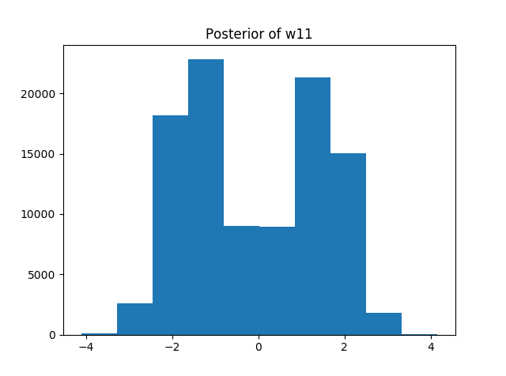
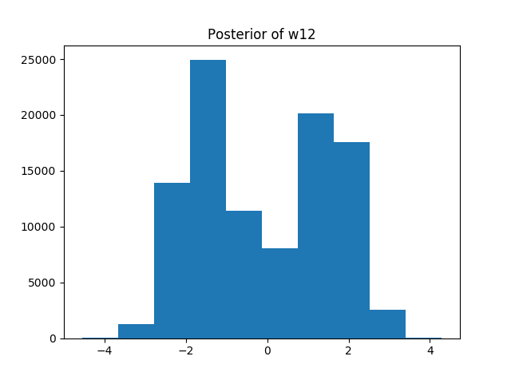
Sanity Check

Slide 63
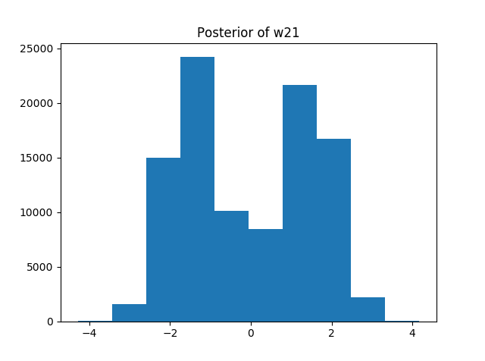
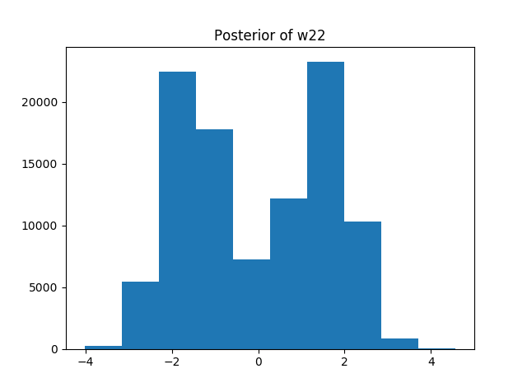
Sanity Check

Slide 64
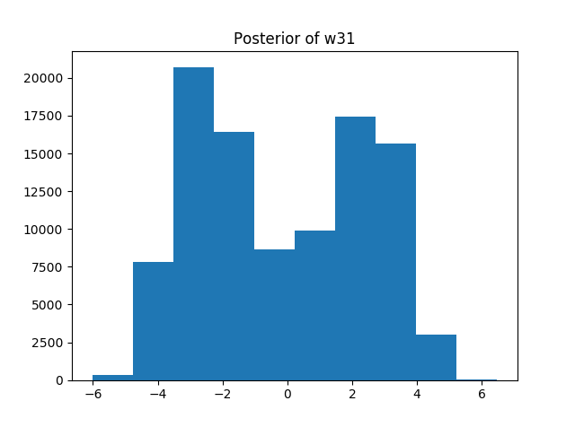
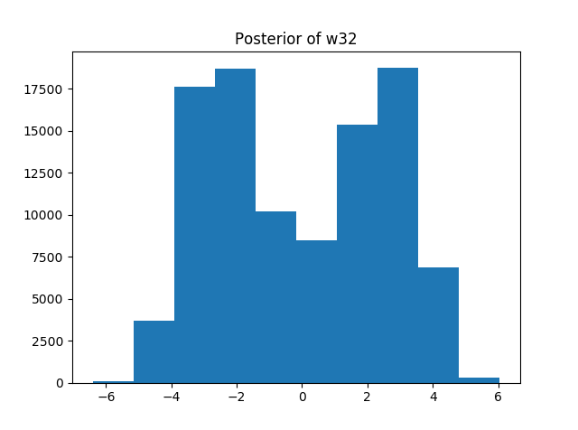
Sanity Check

Slide 65
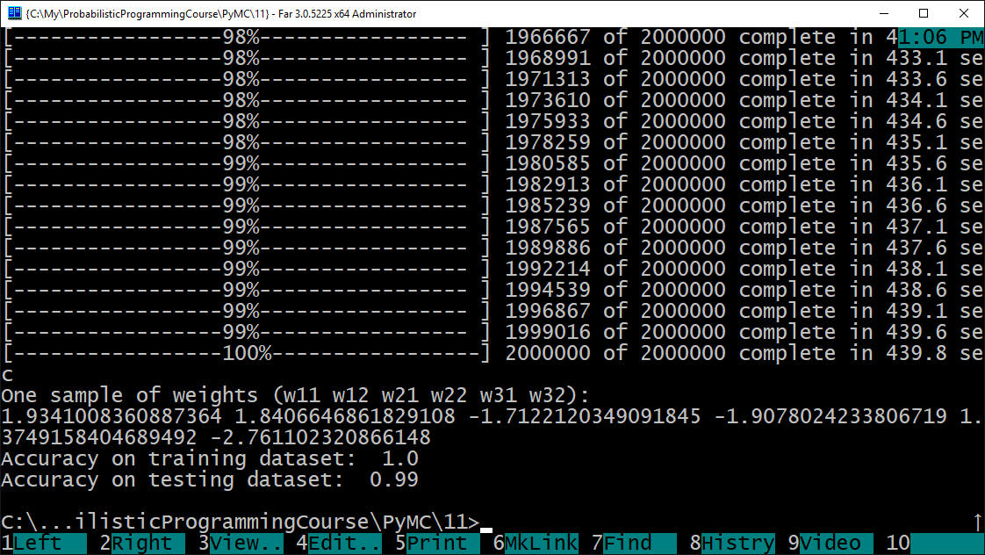
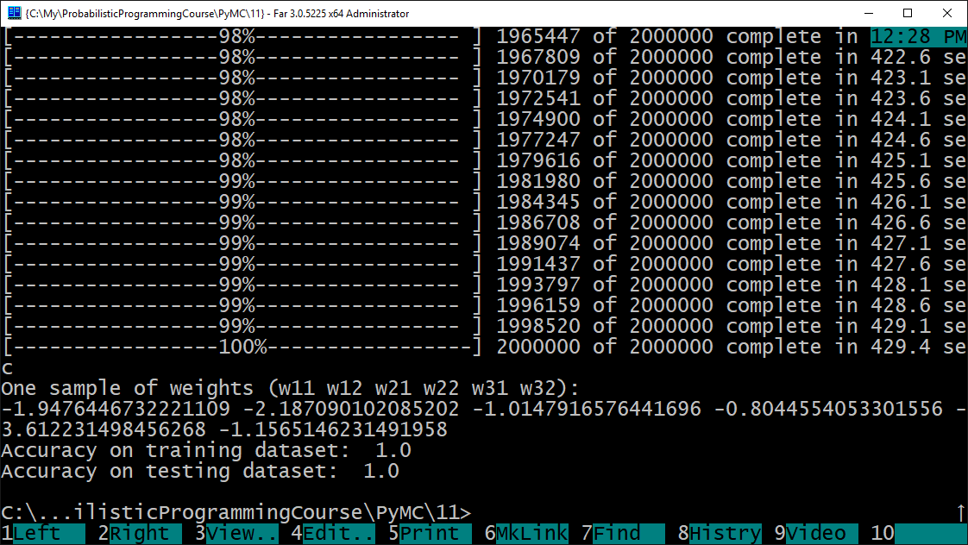
Sanity Check

Slide 66
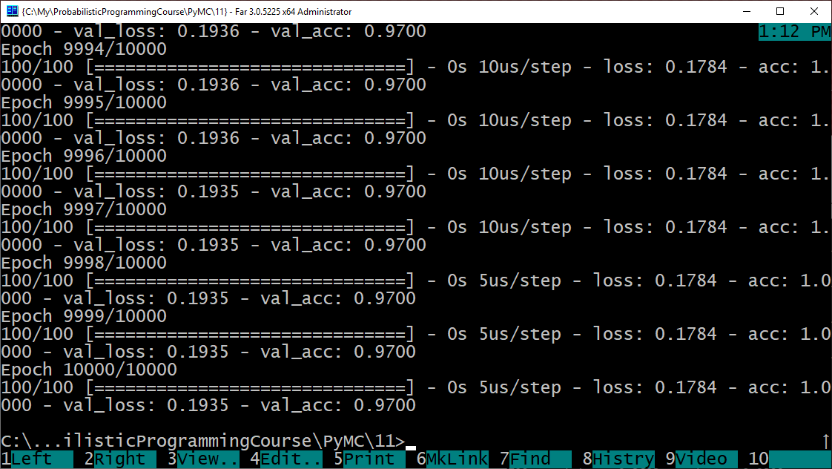
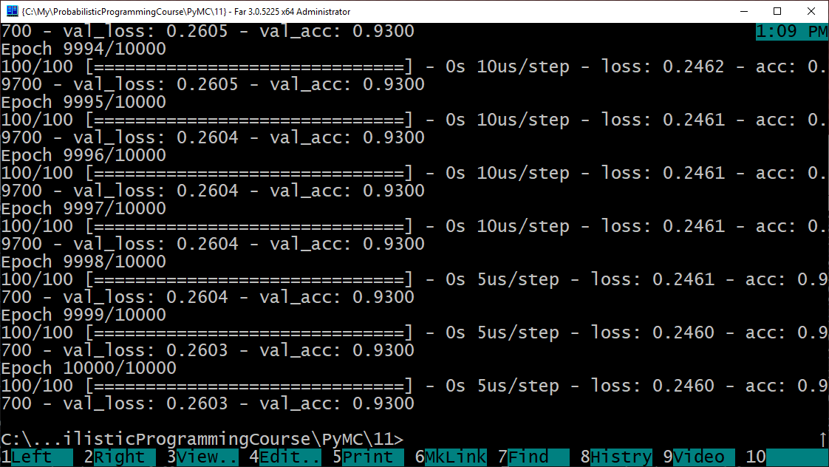
Comparison to “classic” neural networks

Slide 67
Overparametrization May Help Optimization : Folklore Experiment
Generate labeled data by feeding random input vectors Into depth 2 net with hidden layer of size n
Difficult to train a new net using this labeled data with same # of hidden nodes
Much easier to train a new net with bigger hidden layer!
Still no theorem explaining this…
Adapted from Sanjeev Arora's ICML 2018 tutorial “Toward Theoretical Understanding of Deep Learning” (http://unsupervised.cs.princeton.edu/deeplearningtutorial.html)

Slide 68
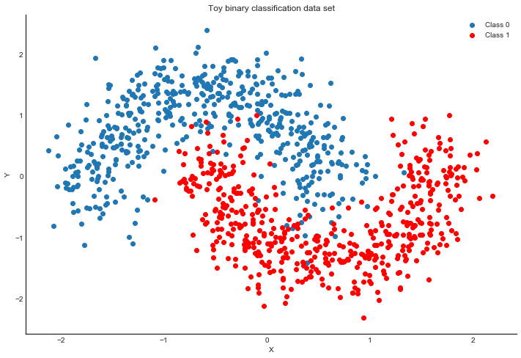
Other small datasets
“Two Moons” dataset: toy dataset for a simple binary classification problem that's not linearly separable.
sklearn.datasets.make_moons(noise=0.2, random_state=0, n_samples=1000)

Slide 69
Extras
Extensions (up to 1.5 points):
Priors over architectures
Weight sharing (CNN, Siamese Networks)
for more ideas see chapter 2 from “Bayesian Learning for Neural Networks”
…

